Slide 1
An FHWA Update
AMOTIA 10th Annual Conference
Tom Everett
Associate Administrator
FHWA Office of Infrastructure
October 2, 2018
Notes:
Thank you for the invitation to speak to you this morning. It’s a pleasure to be here.

Slide 2
Overview
Federal-aid highway program and FHWA organization
Big Initiatives
The future: emerging technologies
Notes:
Three points that I plan to cover in the next 20 minutes.
Reached out to Peter - gave me a half-dozen ideas, most of which I cannot discuss because they cross the line into political views, and I am a career employee.
I shared the topics with Jim Tymon since he does not have the same restrictions as I do.

Slide 3
Federal Highway Program
National Highway Performance Program
Surface Transportation Block Grant Program
Highway Safety Improvement Program
Railway-Highway Grade Crossings
Congestion Mitigation & Air Quality
Improvement Program
National Highway Freight Program
Emergency Relief
Federal Lands and Tribal Transportation Programs
Nationally Significant Freight and Highway Projects
Ferry Boat Program
Puerto Rico Highway Program
Territorial Highway Program
Transportation Alternatives
State Planning & Research
Metropolitan Transportation Planning
Notes:
Federal-aid funds are generally distributed to States using formulas specified in Federal law.
Not actual cash – It’s a promise of future reimbursement.
The funds distribution enables a State DOT, to enter into project agreements with the Federal Highway Administration that will ultimately be reimbursed from Highway Trust Fund receipts.
Funding categories or programs that focus on key areas…(see slide)
Also fund some research activities.

Slide 4
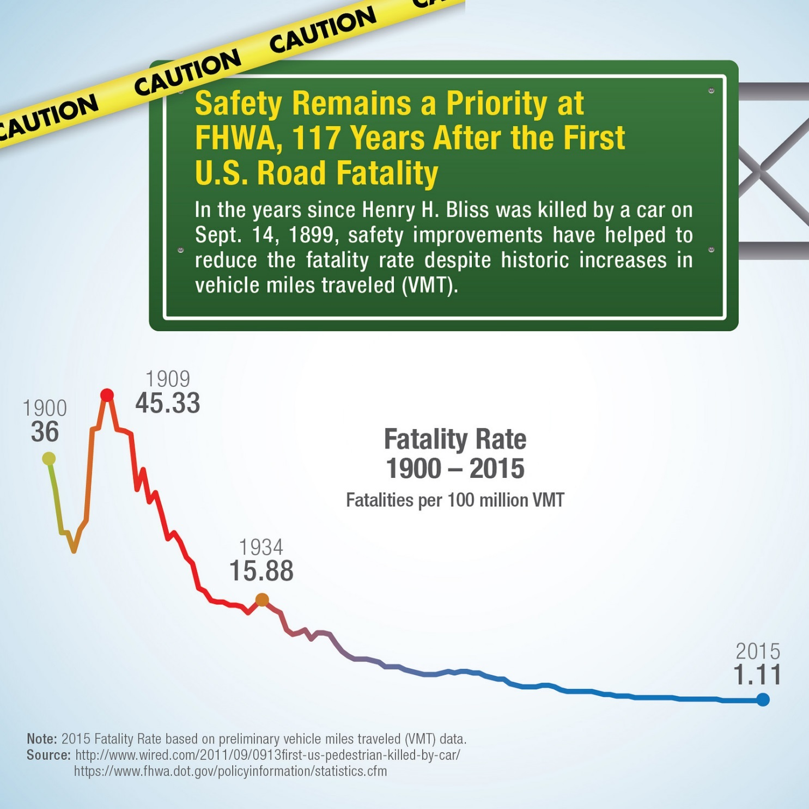
Leadership in Safety
Notes:
What do we do?
Provide Leadership in Safety
Improving highway safety continues to be a priority for us
Our focus is on the highway system – roadside hardware, design, railroad crossing, work zone safety – not the vehicle (although we do partner with NHTSA on some activities).

Slide 5
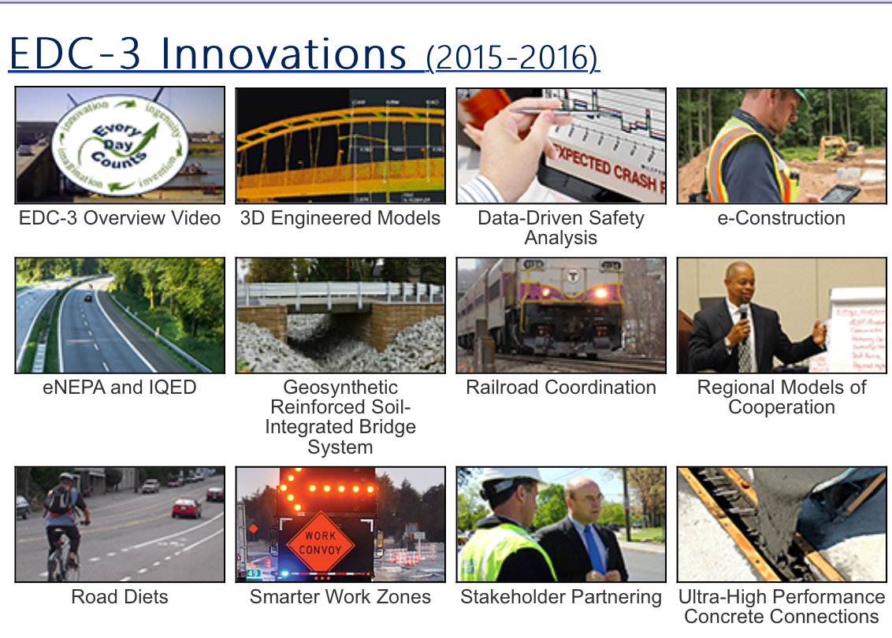
Leadership in Innovation: Every Day Counts
Notes:
2) Provide Leadership in innovation
One way we do this is through our Every Day Counts program
Aimed at deploying underutilized, market-ready, proven strategies to improve Safety and Accelerate project delivery
Select 10 innovations or so every two years to advance in partnership with our stakeholders.
This slide shows the innovations that were chosen for the third round of EDC (EDC-3).
We are now kicking off EDC-5 – 10 innovations selected – 4 from my office:
Project bundling
Advanced geotechnical modeling
Advanced hydraulic modeling
Use of unmanned aerial systems
Once a State decides which innovations they would like to advance with us, we provide resources in the form of technical assistance, training, workshops, other tools.

Slide 6
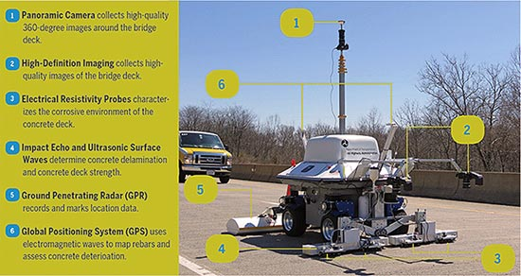
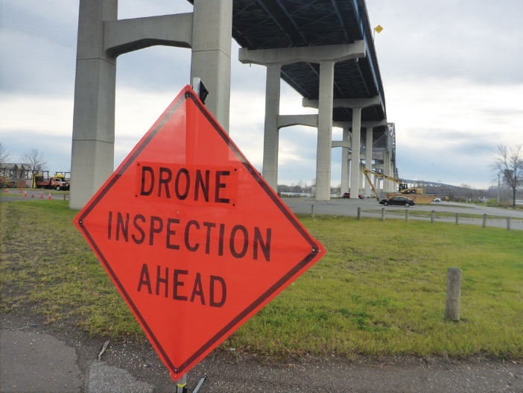
Leadership through Research
Leadership in Research
Notes:
3) Provide leadership in research
Automated inspection technologies and tools
High performance materials
Truck platooning – impacts on infrastructure

Slide 7
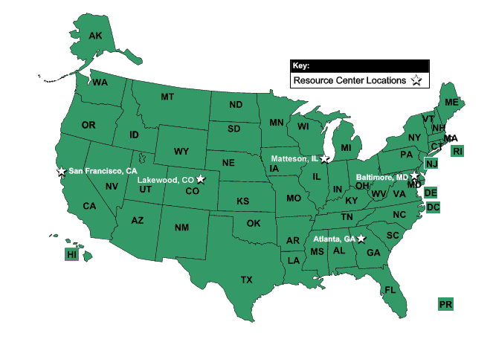
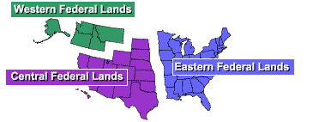
FHWA Field Offices & Staffing
2,023 (73%) of 2,763 employees are located in the Field
Notes:
4) Leadership is delivering projects
Our role is primarily to assist the States
Federally assisted, State program
We are largely field-deployed – offices in each State that works on a daily basis with their State DOT
Supplement the Division offices with a Resource Center – technical assistance, training
HQ and research facility in DC – policy, program direction
Federal Lands – operate much like a State DOT for other Federal agencies, like the Park Service

Slide 8
Office of the Administrator
Office of Innovative Program Delivery
Research, Development, & Technology
Federal Lands Highway
Chief
Counsel
ITS Joint Program Office
Policy and Governmental Affairs
Chief Financial Officer
Administration
Operations
Safety
Infrastructure
Planning, Environment, & Realty
Civil Rights
Public Affairs
Asst. Sec. for Training and Technology
Directors of
Field Services
Director of
Technical Services
Federal-aid Divisions
Resource Center
National Highway Institute
Notes:
Office of the Administrator includes the Administrator, Deputy Administrator; and Acting Executive Director, Cheryl Walker.
The DFS (four) provide administrative supervision and leadership on strategic initiatives to their constituent Federal-aid division offices.
The Director of Technical Services is responsible for the Resource Center, the National Highway Institute, and the Technology Partnership Programs.
Headquarters Offices report to the Office of the Administrator

Slide 9
The Federal-Aid Highway Program
Federally-assisted, State-administered
Each State must have a highway agency
Funding tied to specific categories of roads
States pay for maintenance
Matching requirements (“Federal share”)
Notes:
The Federal-aid highway program took shape in 1916 through 1921.
Instead of building the roads, the government would provide funds to the State highway agencies. They selected the projects on designated systems and were responsible for design and construction. We ensured the projects met Federal requirements and paid 50 percent of project costs.
This basic Federal-State relationship, established in 1916, has been the core and the strength of our program ever since.

Slide 10
~25% of U.S. Road Miles Are Eligible for Federal Assistance
Interstate (subset of NHS) (1.0%)
Other National Highway System (NHS) (4.0%)
Other
public
roads
(76%)
Other
Federal-aid
highways
(19%)
“Federal-aid highways”;
generally eligible
Generally ineligible
(exceptions for bridges
and safety projects)
Notes:
Of the 4 million miles of public roads in the U.S., about 3 million (76%) fall within the lowest two functional classes: local roads and rural minor collectors. (shown on slide as other public roads)
Generally speaking, Federal funding may not be used on these types of roads – though as you see here, there are exceptions for bridge rehabilitation and replacement, and for safety projects (among others).
Roads that are eligible are shown in blue.
FHWA refers to the remaining million miles of road (24%) as “Federal-aid highways”. Includes the national highway system mentioned earlier.

Slide 11
Total U.S. Highway Spending, 2014
Total Highway Spending
Capital Outlay
$238.4B
$105.5 B
Notes:
A word about highway spending… States and locals pay for the majority of highway investment.
The Federal role is important, but, we’re not the biggest game in town.
On the left you see a chart showing total spending for highways—a combination of capital outlay, maintenance, and operating costs. States paid about half, and locals another 32%. The Feds paid 20%. (2014 data)
On the right you see a chart showing funding for capital outlay: construction projects, reconstruction projects, etc. Since Federal funds tend to be focused on capital projects, the Federal share here is larger, but still covered less than half of all highway capital outlays.
These are national averages. Some States are more dependent on the FAHP than others. Typically large land area States with small populations are more dependent.

Slide 12
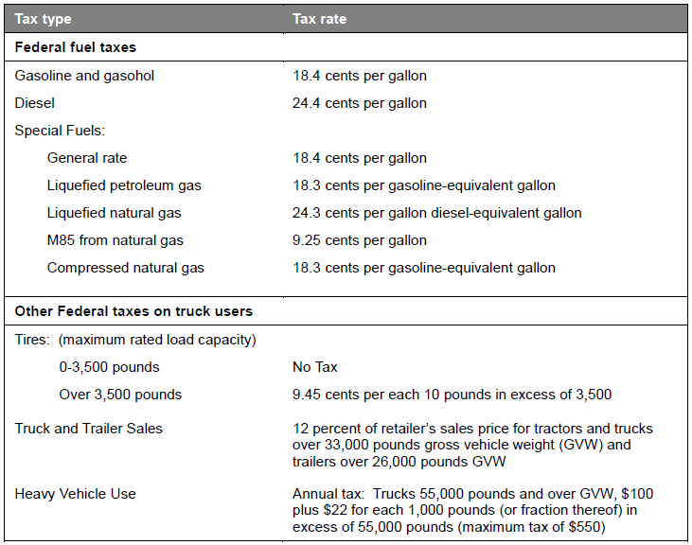
Highway Trust Fund – Current Tax Rates
Notes:
User tax-based mechanism to fund most Federal surface transportation programs
Revenues: primarily fuel taxes (18.4¢/gallon gasoline, 24.4¢/gallon diesel)
Most $ to Highway Account (some to Mass Transit Account). That completes my quick overview of the FAHP.
For the past several years, Congress has supplemented the HTF w/ General funds to cover our program needs.
Jim may talk about the long-term outlook, so I’ll move to the next topic.

Slide 13
Big Initiatives
Reauthorization
Transportation Performance Management and Asset Management
Competitive highway bridge program
Emergency Relief
Proprietary Products
Notes:
Shift to a few of the hot topics for my office (not a comprehensive list).

Slide 14
Fixing America’s Surface Transportation
(FAST) Act
14
Signed into law Dec. 4, 2015
(P.L. 114-94)
Highways, highway safety, transit, research, and railroads
5-year legislation – FY 2016-2020
  $305 B in total authorizations
  $225 B authorized for Federal aid Highway Program
  $70 B in transfers to keep Highway Trust Fund solvent
Motor carrier safety (1%)
Highway safety (1.5%)
Rail (3%)
Transit
(20%)
Federal-aid Highways (74%)
Notes:
Reauthorization: The FAST Act expires at the end of Fiscal Year 2020—September 30, 2020.
Since December 2015, when the FAST Act was enacted, FHWA has worked diligently to implement the law, educate our partners—including the States—on changes to our programs, and put Federal funding to work for the American people and economy.
But time flies, and we are starting to look ahead at the expiration of the FAST Act, which is really just around the corner.
As we get closer to the end of the FAST Act, FHWA will be working to support the Secretary and her office as they develop a reauthorization proposal for the Administration.
I anticipate that the Department’s reauthorization process will begin to gear up over the coming months.
We encourage States, and other stakeholders to meet with us or send over any policy proposals or ideas.

Slide 15
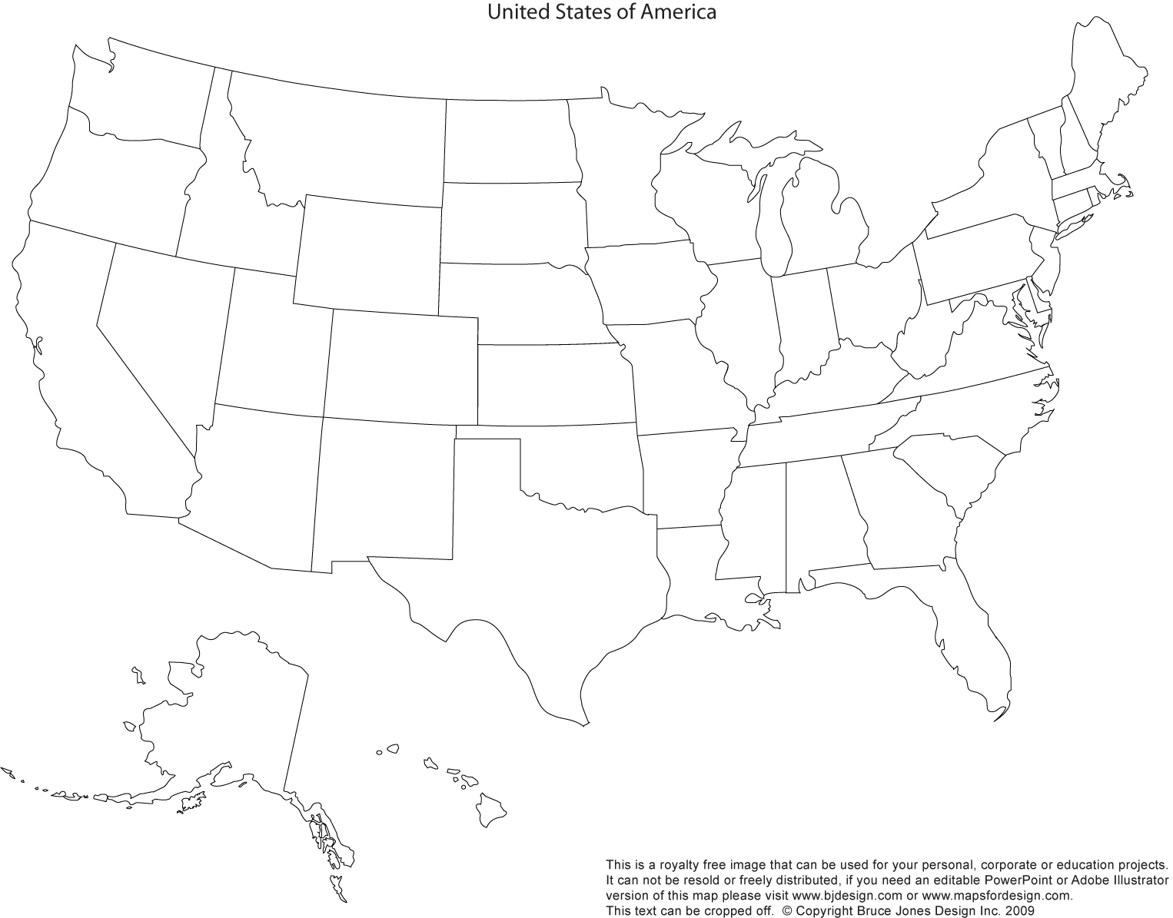
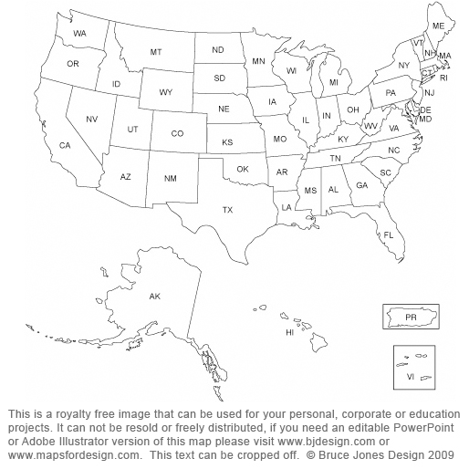
Competitive Highway Bridge Program
$225M for highway bridge replacement and rehabilitation projects on public roads.
Projects must demonstrate cost savings through bundling [23 U.S.C. 144(j)]
Funding comes from the General Fund and requires a match (80%/20% or sliding scale).
Funds must be obligated by September 30, 2021 (must be expended by September 30, 2026).
Funding is eligible to States with a population density of less than 100 people per square mile based on the 2010 census and a State’s total land area.
States Eligible for the FY18 Omnibus Competitive Highway Bridge Program
Notes:
The new Competitive Highway Bridge Program provides up to $225M in grants to states for highway bridge replacement or rehabilitation. Proposals must bundle (2 or more) bridges into a single project. Eligible states are based on population density and are shown on the map. The intent of this program is to provide an additional funding for use on rural bridges.
Requirements were published in the Federal Register on 9/5. Eligible State DOTs have 90 days (December 4th) to apply for grants to rehabilitate or replace two or more highway bridges that meet the program’s selection criteria and are bundled into a single project.
As the funding is for replacement or rehabilitation, the program will likely target bridges in poor condition.
Since the funding must be obligated before Sep. 30, 2021 and expended before Sep. 30, 2026, the bridge projects will likely have to already be through the NEPA process or are expected to qualify as a Categorical Exclusion.
Bridge projects cannot already be authorized for construction using another source of Federal funding.

Slide 16
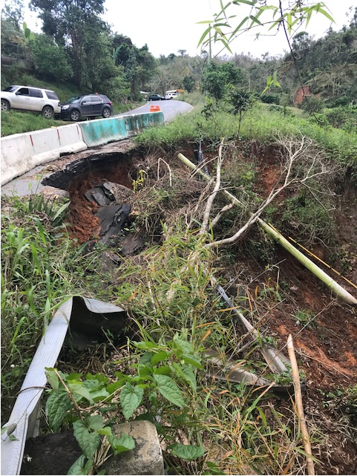
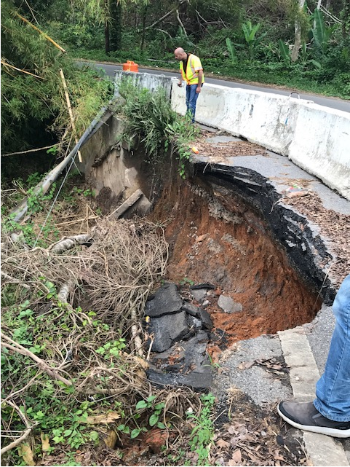
Emergency Relief Program
Highway PR-135, Km.18.9 in Adjuntas, PR
Notes:
23 U.S.C. 125 authorizes an Emergency Relief (ER) program for the repair or reconstruction of Federal-aid highways and roads on Federal lands that have suffered serious damage as a result of natural disasters or catastrophic failures from an external cause.
How does this align with FEMA aid? FEMA covers the non-Fed-aid highways and debris removal when the President declares an emergency (Stafford Act events).
- The FHWA allocates ER funds by two methods: periodic nationwide allocations and Quick Release allocations. In some cases, funds are also allocated as directed by Congress (i.e. supplemental funding for a specific event)
- Over the past 3 fiscal years, there has been an average of 17 Quick Releases per year.
- The ER program has a permanent annual authorization of $100 million, which is available to the 50 States, the District of Columbia, Puerto Rico, American Samoa, the Commonwealth of the Northern Mariana Islands, Guam, the U.S. Virgin Islands, Federal Land Management Agencies and tribal governments.
- Over the last decade, ER needs have significantly exceeded the annual authorization, resulting in the buildup of a backlog of ER funding needs.
Shortfall Needs (needs where funds have not yet been allocated): $2.2 billion (as of 9/4/2018 – does not include Hurricanes Lane and Florence)
Shortfall (unable to support with funds on hand): $1.4 billion (as of 9/4/2018 – does not include Hurricanes Lane and Florence)
Congress has periodically provided supplemental appropriations to address specific large-scale disasters and the growing ER shortfall.

Slide 17
Proprietary Products
March 27, 2018: American Road and Transportation Builders Association (ARTBA) submitted a Petition for Rulemaking to repeal the patented and proprietary materials requirements in 23 CFR 635.411.
FHWA is preparing a rulemaking that will propose changes to 23 CFR 635.411.
December 2018
Notes:
FHWA Current Regulation and Policy
23 CFR 635.411 allows FHWA participation only when:
Competitively bid; or
State DOT Certification that product is either
Required for synchronization with existing highway facilities; or
No suitable alternate exists; or
Experimental/Research purposes; or
If there are other equally acceptable materials or products available, a specific material or product may be specified when the Division Administrator approves of its use as being in the public interest
The regulation is based on the competitive bidding principles in 23 U.S.C. 112 which requires that each construction contract be awarded to the lowest responsive bid, unless another more cost-effective method is used or an emergency exists.

Slide 18
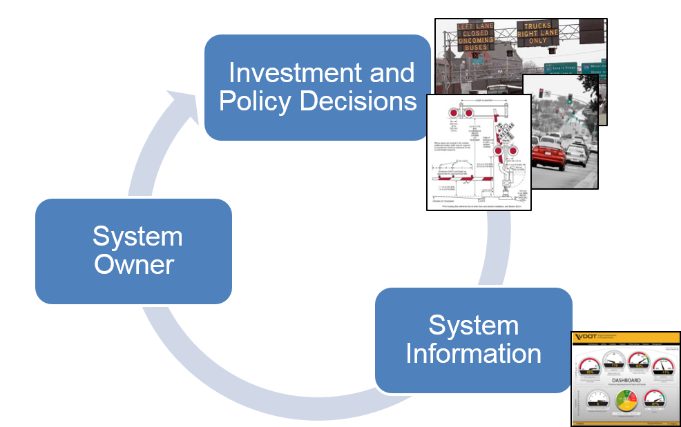
Transportation Performance Management
A strategic approach that uses system information to make investment and policy decisions to achieve transportation system performance goals.
Notes:
The approach of using information about your system to inform investment and policy decisions in support of targets based on performance measures and national goals is called Transportation Performance Management (TPM)
Transformative to the Federal program and we’re still in the early stages
Recent regulations have established performance measures in several areas, including bridge and pavement conditions on the National Highway System

Slide 19
§ 490.307 Performance Measures
Pavement Measures
23 CFR 490.307
Pavement Condition Measures
Interstate System | Non-Interstate NHS
Percentage of pavements of the Interstate System in Good condition | Percentage of pavements of the non-Interstate NHS in Good condition
Percentage of pavements of the Interstate System in Poor condition | Percentage of pavements of the non-Interstate NHS in Poor condition
Notes:
Pavement condition is a critical goal for every agency
States will be setting targets for pavements in good and poor condition on the Interstate and non-Interstate NHS.
Performance periods are four years
There is a minimum condition for Interstate pavements – lane miles in poor condition < 5%, except in AK <10%
What’s the penalty for not meeting the minimum? a greater portion of the States’ federal-aid funding being directed toward upkeep of the Interstate system.

Slide 20

Risk-based Asset Management Plan
Plan Contents:
    Pavement and bridge inventory and conditions on the NHS.
    Objectives and measures.
    Performance gap identification.
    Life-cycle planning
    Risk management analysis.
    Financial plan.
    Investment strategies.
Notes:
Hand-in hand with moving to a performance based program is a requirement for States to develop and utilize Risk-Based Asset Management
Goal is to establish a decision making framework that makes it possible to view the impact of today’s decisions on tomorrow's infrastructure sustainability, both in terms of performance and value.
New regulations define 7 key items to be included in an asset management plan – see slide
Asset management is not just preservation, not a computer program, not a system…
It is a framework for decision making and a way to support and be accountable for the decisions.

Slide 21

Transportation Asset Management Plan (TAMP) Status
All States submitted their initial Transportation Asset Management Plans (TAMPS). The work of the State DOTs and FHWA Division Offices is acknowledged and appreciated.
In some cases, we have work to do to encourage the growth of maturity in the processes used to develop the TAMPs.
2
Notes:
All 50 States, the District of Columbia, and Puerto Rico submitted Initial State DOT Asset Management Plans (TAMPs) by the required due date of April 30, 2018. FHWA Divisions reviewed the TAMPs that were submitted and certified 37 that had processes compliant with Federal laws and regulations. As of September 19, 2018, with 15 State DOTs plans conditionally approved.
Shooting for a June 2019 date to have fully developed and implemented AM plans.

Slide 22
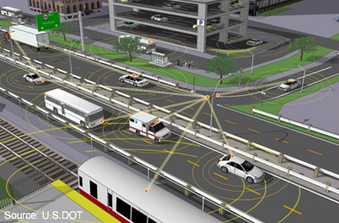
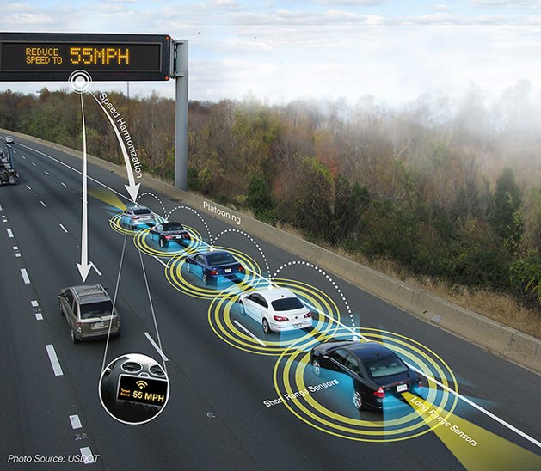
Connected Vehicles and Infrastructure
Emerging Technologies
Autonomous Vehicles
Notes:
New technologies such as connected and autonomous vehicles will not only provide for increased safety and efficiency, but may also lead to transportation service and mobility options that are yet to be realized.
Truck platooning has arrived.

Slide 23


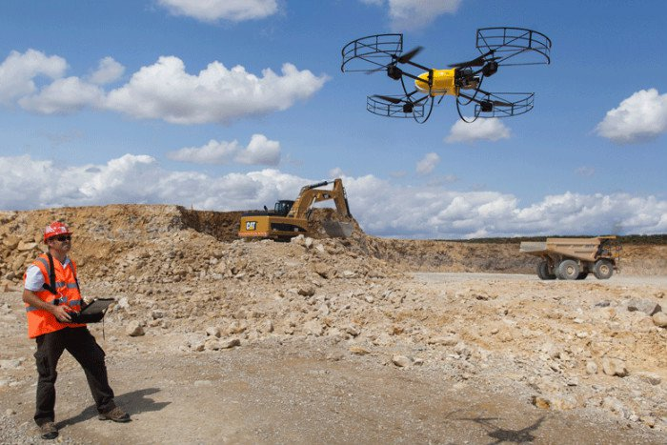

The Future: Unmanned Aerial Systems (UAS)
UAS Usage
  Surveying and Mapping
  Remote Inspection
  Geospatial Tagging
  Operations and Incident Management
  Construction
FHWA UAS website: https://www.fhwa.dot.gov/uas/
Notes:
New three-year UAS Integration Pilot Program will allow local and state governments to:
Expedite the approval process for airspace authorizations pertaining to specific operations.
Work closely with private sector partners on advanced commercial drone operations and applications of technology.
Inform standard operational procedures.
Demonstrate technical and operational solutions that reduce the need for waivers.
Incorporate community participation to provoke meaningful dialogue relative to drone operations.
Secretary Chao announced 10 recipients in May. Identified on web site.
Over the next two and a half years, the selectees will collect drone data involving night operations, flights over people and beyond the pilot’s line of sight, package delivery, detect-and-avoid technologies and the reliability and security of data links between pilot and aircraft.
The data collected will help USDOT and FAA craft new enabling rules that allow more complex low-altitude operations, identify ways to balance local and national interests related to UAS integration, improve communications with local, state, and tribal jurisdictions, address security and privacy risks, and accelerate the approval of operations that currently require special authorizations.
In addition, the FHWA UAS Working Group has formed and is beginning to move forward on several activities such as:
Continuing monthly webinar series on UAS use.
Funded research on “Collection, Analysis, and Interpretation of Data Obtained from Unmanned Aerial Systems (UAS) for Bridges,” proposals are under review.
Supporting PIARC Project, “The Use of Unmanned Aerial Systems (UAS) to Remotely Collect Data for Road Infrastructure.”
Supporting NCHRP domestic scan, "Successful Approaches for the Use of Unmanned Aerial Systems by Surface Transportation Agencies" to provide a starter guide and case studies that transportation agencies can use to improve or start their own UAS initiatives.
Planning to conduct a national information sharing workshop. The goal would be to bring together key FHWA personnel, State personnel, Industry, and Academia who are actively using and advancing UAS technology and gather a working knowledge of the state of the practice.

Slide 24
Thank You!

